Slide 1
Vehicle Dynamics and Simulation
Linearity and State Space
Dr B Mason

Slide 2
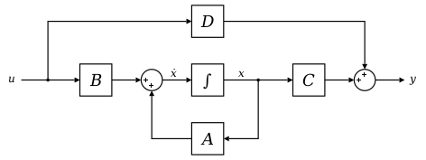
Lecture overview
Linear systems
State-space representation

Slide 3
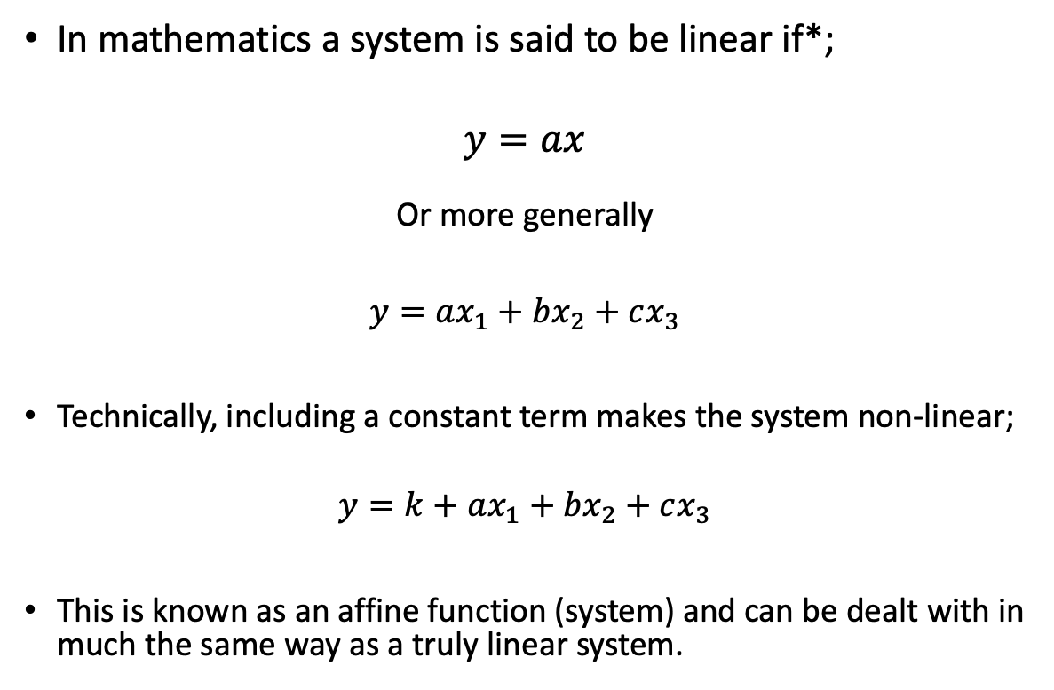
Linear Systems
Linear Systems
In mathematics a system is said to be linear if*;
$$y=ax$$
Or more generally
$$y=ax_{1}+bx_{2}+cx_{3}$$
Technically, including a constant term makes the system non-linear;
$$y=k+ax_{1}+bx_{2}+cx_{3}$$
This is known as an affine function (system) and can be dealt with in much the same way as a truly linear system.
y=ax
y=k+ax
*the actual definition is a bit more technical and is written in terms of the principle of superposition,
we will focus on linear systems so the exact definition doesn’t matter (but please look it up!)

Slide 4
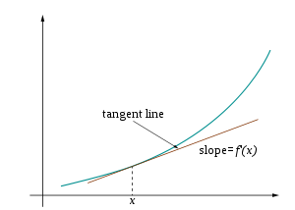
Linear Systems
correction…traced out by the green line, f(x) …
Linear systems are important since the mathematics around them is more fully developed.
There are many open questions around non-linear systems including finding of more general solutions.
Most non-linear systems can be linearised (around a point) which provides a means of making some intractable nonlinear system problems tractable.
Linearisation around x for f(x). Note that the approximation is good close to x but less good as one moves away from x to f(x+h) for example.

Slide 5

Linear or non-linear??
System Equations
$${\dot{x}}_{1}=x_{2}$$
$${\dot{x}}_{2}=\frac{K}{M}\left(x_{3}−x_{2}\right)+\frac{B_{s}}{M}(u−x_{2})$$
$${\dot{x}}_{3}=u$$

Slide 6
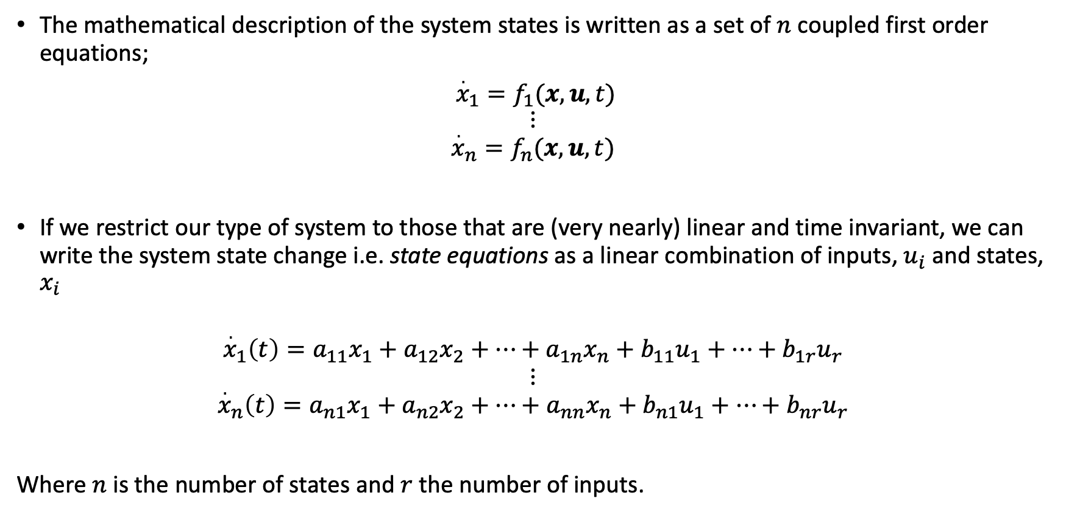
Linear Systems
The mathematical description of the system states is written as a set of $n$ coupled first order equations;
${\overset{.}{x}}_{1}=f_{1}(x,u,t)$
$$⋮$$
$${\overset{.}{x}}_{n}=f_{n}(x,u,t)$$
If we restrict our type of system to those that are (very nearly) linear and time invariant, we can write the system state change i.e. state equations as a linear combination of inputs, $u_{i}$ and states, $x_{i}$
$${\overset{.}{x}}_{1}\left(t\right)=a_{11}x_{1}+a_{12}x_{2}+⋯+a_{1n}x_{n}+b_{11}u_{1}+…+b_{1r}u_{r}$$
$$⋮$$
$${\overset{.}{x}}_{n}\left(t\right)=a_{n1}x_{1}+a_{n2}x_{2}+⋯+a_{nn}x_{n}+b_{n1}u_{1}+…+b_{nr}u_{r}$$
Where $n$ is the number of states and $r$ the number of inputs.

Slide 7
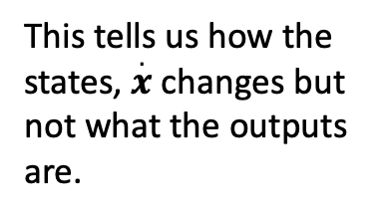
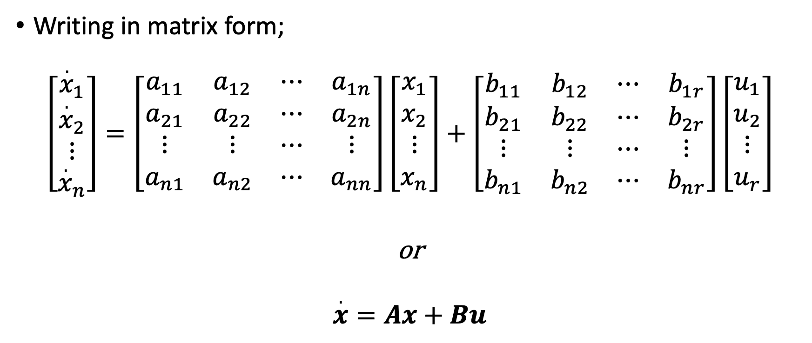
State Space Representation
Writing in matrix form;
$$\left[\begin{matrix}{\overset{.}{x}}_{1} \\ {\overset{.}{x}}_{2} \\ \begin{aligned}⋮ \\ {\overset{.}{x}}_{n}\end{aligned}\end{matrix}\right]=\left[\begin{matrix}a_{11} & a_{12} & ⋯ & a_{1n} \\ a_{21} & a_{22} & ⋯ & a_{2n} \\ ⋮ & ⋮ & ⋯ & ⋮ \\ a_{n1} & a_{n2} & ⋯ & a_{nn}\end{matrix}\right]\left[\begin{matrix}x_{1} \\ x_{2} \\ ⋮ \\ x_{n}\end{matrix}\right]+\left[\begin{matrix}b_{11} & b_{12} & ⋯ & b_{1r} \\ b_{21} & b_{22} & ⋯ & b_{2r} \\ ⋮ & ⋮ & ⋯ & ⋮ \\ b_{n1} & b_{n2} & ⋯ & b_{nr}\end{matrix}\right]\left[\begin{matrix}u_{1} \\ u_{2} \\ ⋮ \\ u_{r}\end{matrix}\right]$$
or
$$\overset{.}{x}=Ax+Bu$$
This tells us how the states, $\overset{.}{x}$ changes but not what the outputs are.

Slide 8
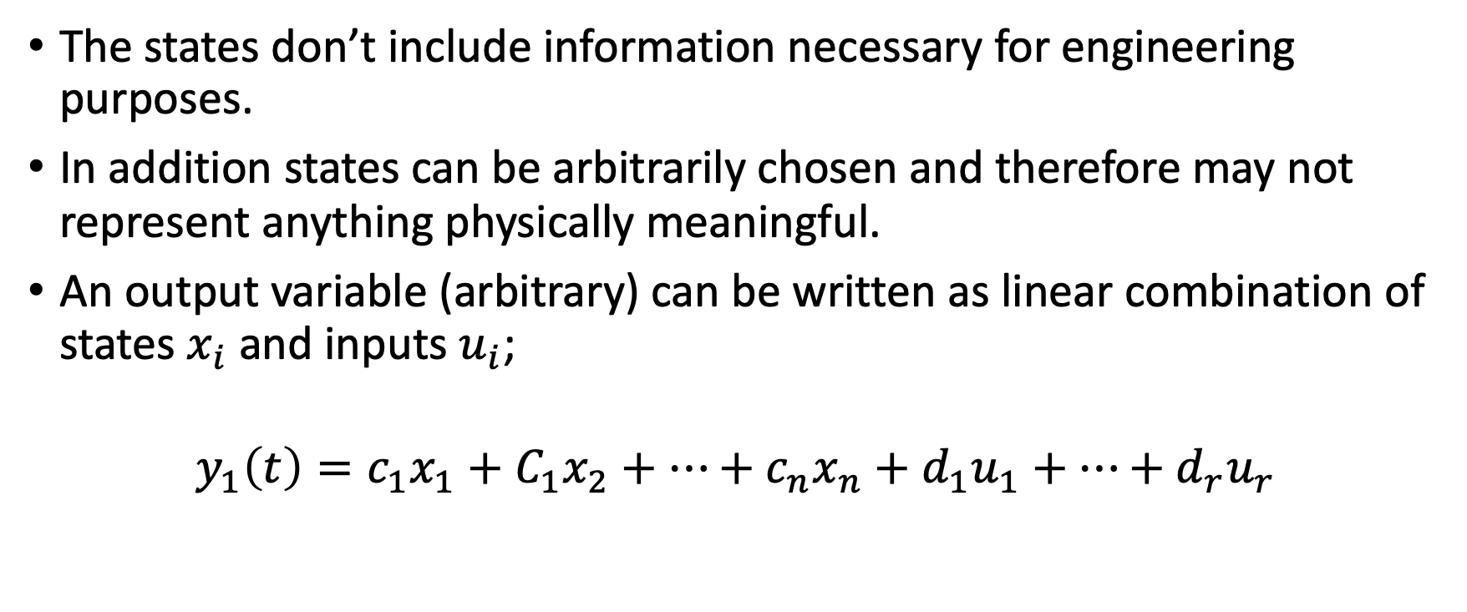
State Space Representation
The states don’t include information necessary for engineering purposes.
In addition states can be arbitrarily chosen and therefore may not represent anything physically meaningful.
An output variable (arbitrary) can be written as linear combination of states $x_{i}$ and inputs $u_{i}$;
$$y_{1}\left(t\right)=c_{1}x_{1}+C_{1}x_{2}+⋯+c_{n}x_{n}+d_{1}u_{1}+…+d_{r}u_{r}$$

Slide 9
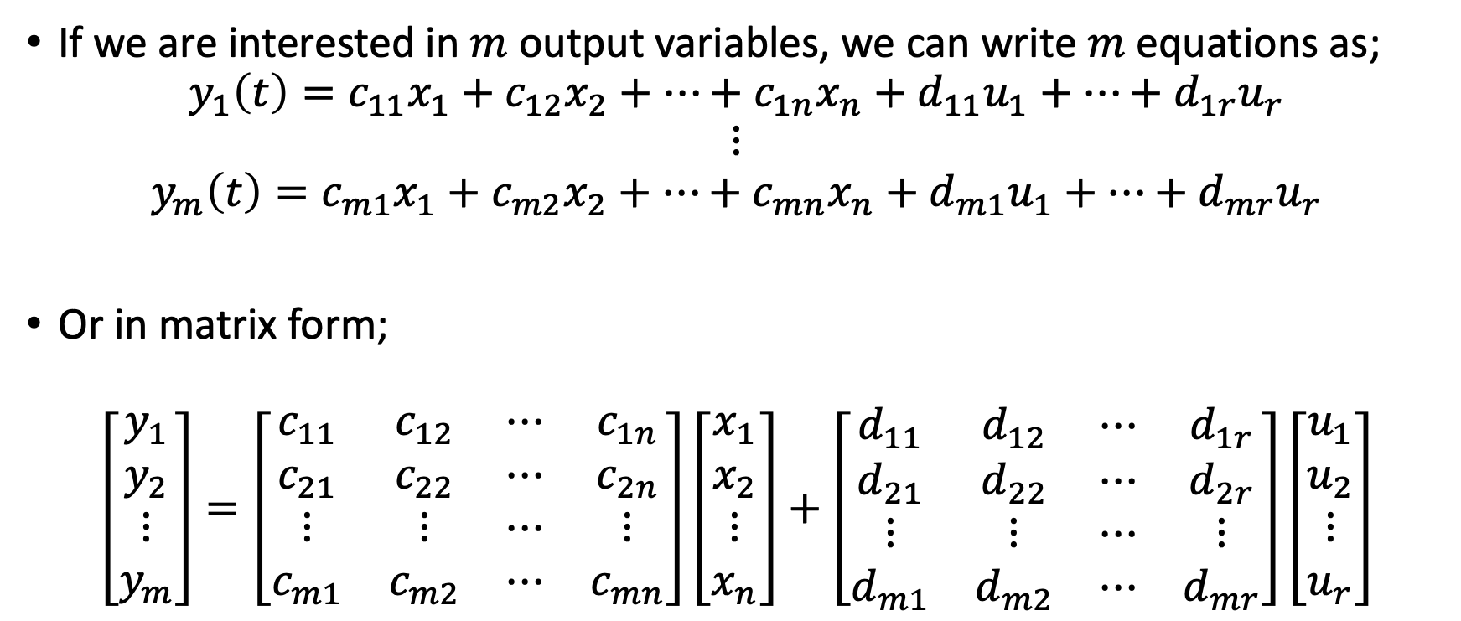
State Space Representation
If we are interested in $m$ output variables, we can write $m$ equations as;
$$y_{1}\left(t\right)=c_{11}x_{1}+c_{12}x_{2}+⋯+c_{1n}x_{n}+d_{11}u_{1}+…+d_{1r}u_{r}$$
$$⋮$$
$$y_{m}\left(t\right)=c_{m1}x_{1}+c_{m2}x_{2}+⋯+c_{mn}x_{n}+d_{m1}u_{1}+…+d_{mr}u_{r}$$
Or in matrix form;
$$\left[\begin{matrix}y_{1} \\ y_{2} \\ \begin{aligned}⋮ \\ y_{m}\end{aligned}\end{matrix}\right]=\left[\begin{matrix}c_{11} & c_{12} & ⋯ & c_{1n} \\ c_{21} & c_{22} & ⋯ & c_{2n} \\ ⋮ & ⋮ & ⋯ & ⋮ \\ c_{m1} & c_{m2} & ⋯ & c_{mn}\end{matrix}\right]\left[\begin{matrix}x_{1} \\ x_{2} \\ ⋮ \\ x_{n}\end{matrix}\right]+\left[\begin{matrix}d_{11} & d_{12} & ⋯ & d_{1r} \\ d_{21} & d_{22} & ⋯ & d_{2r} \\ ⋮ & ⋮ & ⋯ & ⋮ \\ d_{m1} & d_{m2} & ⋯ & d_{mr}\end{matrix}\right]\left[\begin{matrix}u_{1} \\ u_{2} \\ ⋮ \\ u_{r}\end{matrix}\right]$$

Slide 10
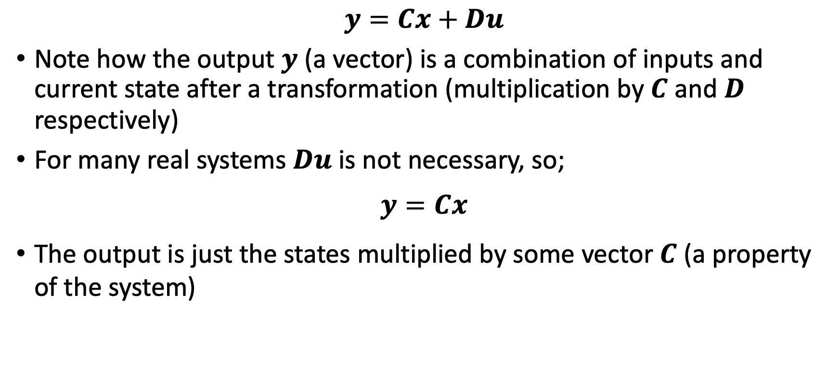
State Space representation
$$y=Cx+Du$$
Note how the output $y$ (a vector) is a combination of inputs and current state after a transformation (multiplication by $C$ and $D$ respectively)
For many real systems $Du$ is not necessary, so;
$$y=Cx$$
The output is just the states multiplied by some vector $C$ (a property of the system)
* Matrix transformation

Slide 11
Conclusion
Linear systems
State space representation

Slide 12
Tutorial

Slide 13

Tutorial - State Space Representation
Try for yourself;
Spring stiffness; $\frac{1}{K}=\frac{1}{K_{s}}+\frac{1}{K_{t}}$
$$F_{s}=…$$
$$F_{s}=K\left(z_{b}−z_{r}\right)+B_{s}({\overset{.}{z}}_{b}−{\overset{.}{z}}_{r})$$
$$ΣF=ma$$
$$−F_{s}=M{\ddot{z}}_{b}$$
$$M{\ddot{z}}_{b}=K\left(z_{r}−z_{b}\right)+B_{s}({\overset{.}{z}}_{r}−{\overset{.}{z}}_{b})$$
Sign convention: +ve direction indicated
by arrow heads
(1)

